Slide 1

Warehouse Inventory Check

Slide 2





The Team
SAGAR GUPTA 9819694602
gupta.sagar@iitgn.ac.in
AKHILESH RAVI 9448730908 akhilesh.ravi@iitgn.ac.in
OMKAR KADAM 9428174462 kadam.devidas@iitgn.ac.in
SUSHRUT SURVE 9820851020 surve.sushrut@iitgn.ac.in

Slide 3
Project Objective and approach
OBJECTIVE: To make a drone that can autonomously fly 2.5 m above the ground and move through a warehouse by detecting the path and detecting the barcodes and QR codes on the boxes in the warehouse. Additionally, it should identify whether the products are hazardous or not and make an overall database.
Image Processing:
Primitive method/shutter speed
Deep learning
Geometry and clarity (unblurred image)
Path Detection:
Edges of yellow lines
Perpendicular lines
Quadcopter
type of quad and stability
reason of arrangement of stuff.
command execution way.
DATA MANAGEMENT -
technique to transfer data.

Slide 4
Design (Components and technique used )
Path Detection
Yellow line detection (edge detection, Hough transform,dilation, etc.)
Line detection problem solved
Quadcopter
Image processing for data extraction
Data Localisation (Deep Learning)
Decoding
Segregation
Hazard Symbol

Slide 5
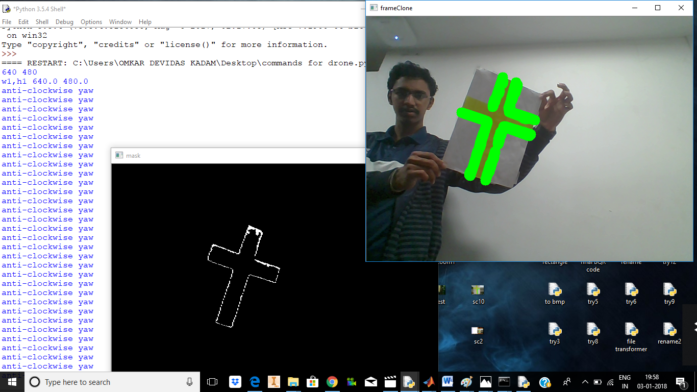

Slide 6
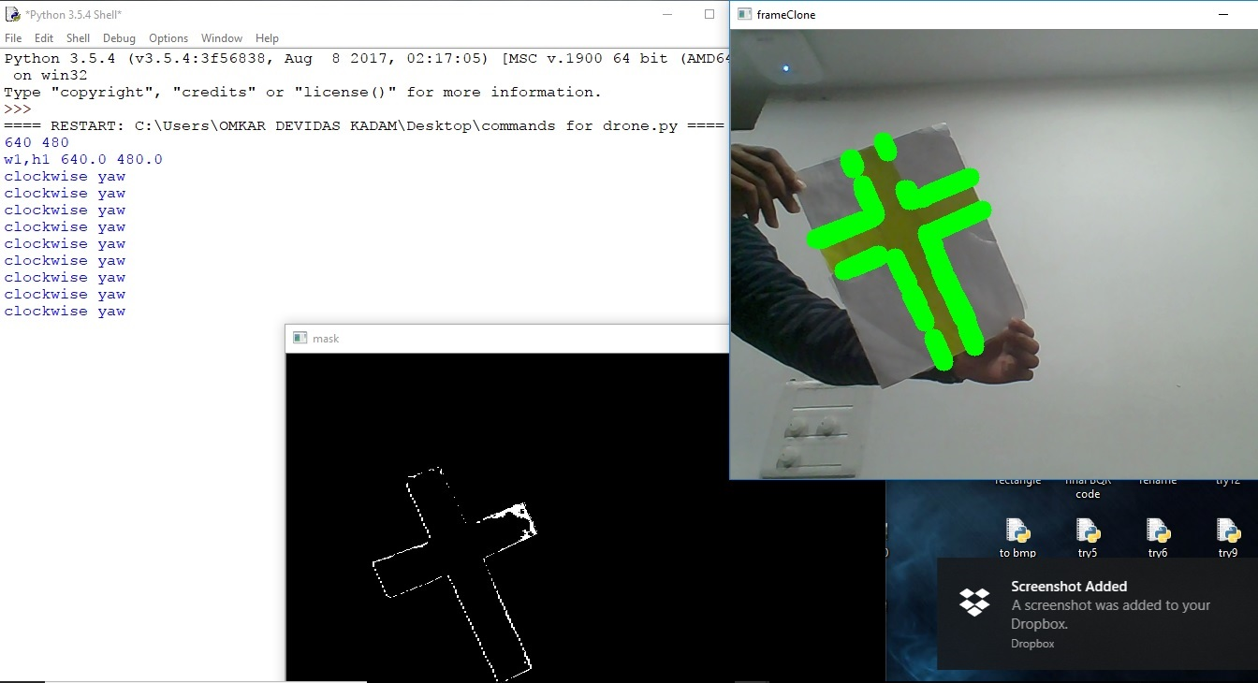

Slide 7
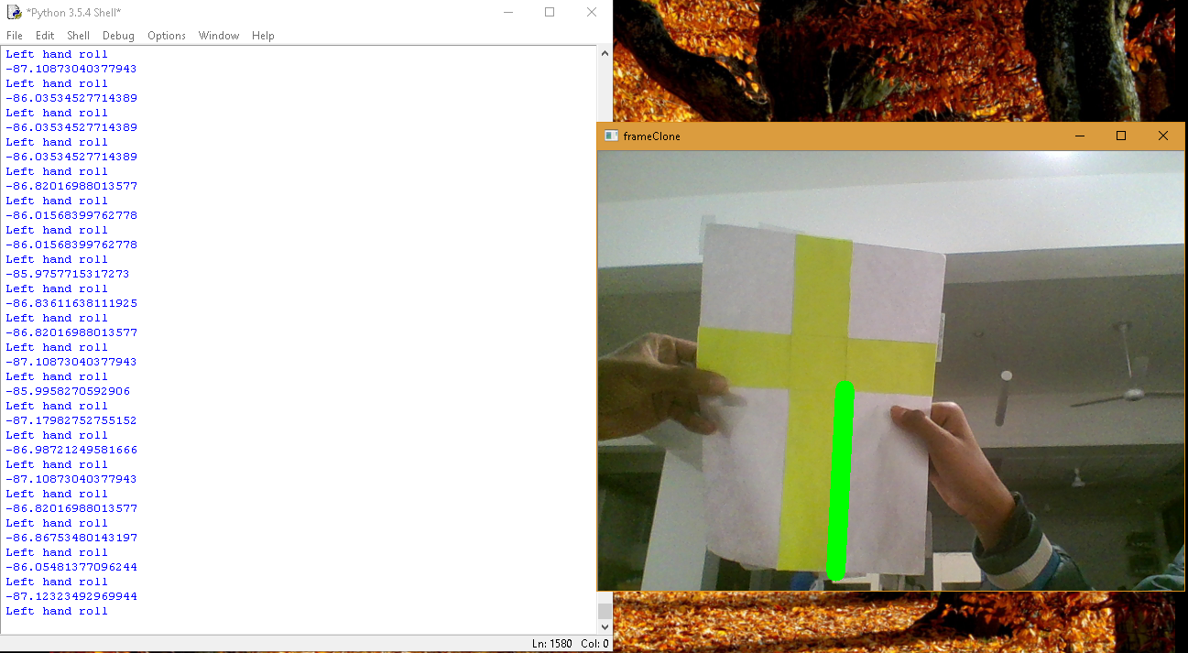

Slide 8
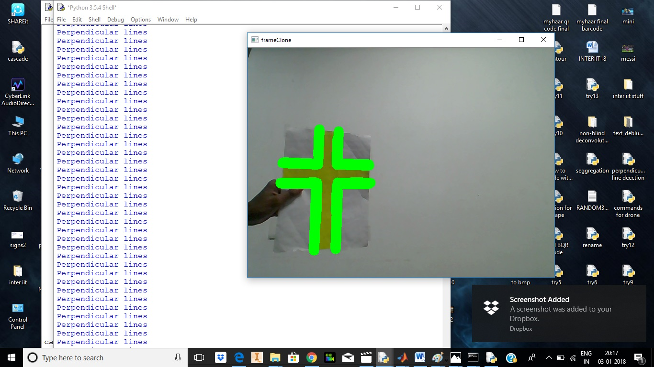

Slide 9
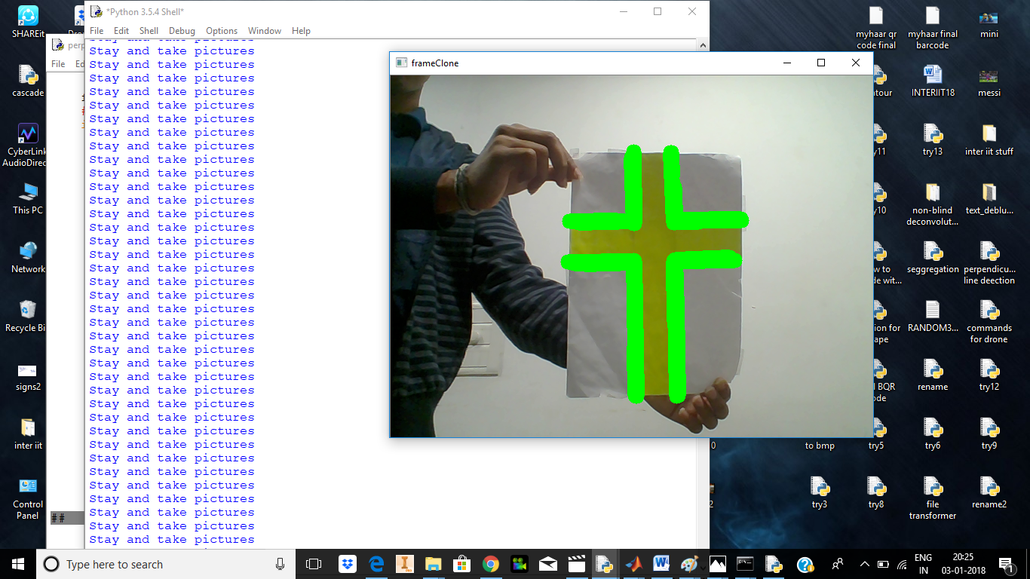

Slide 10
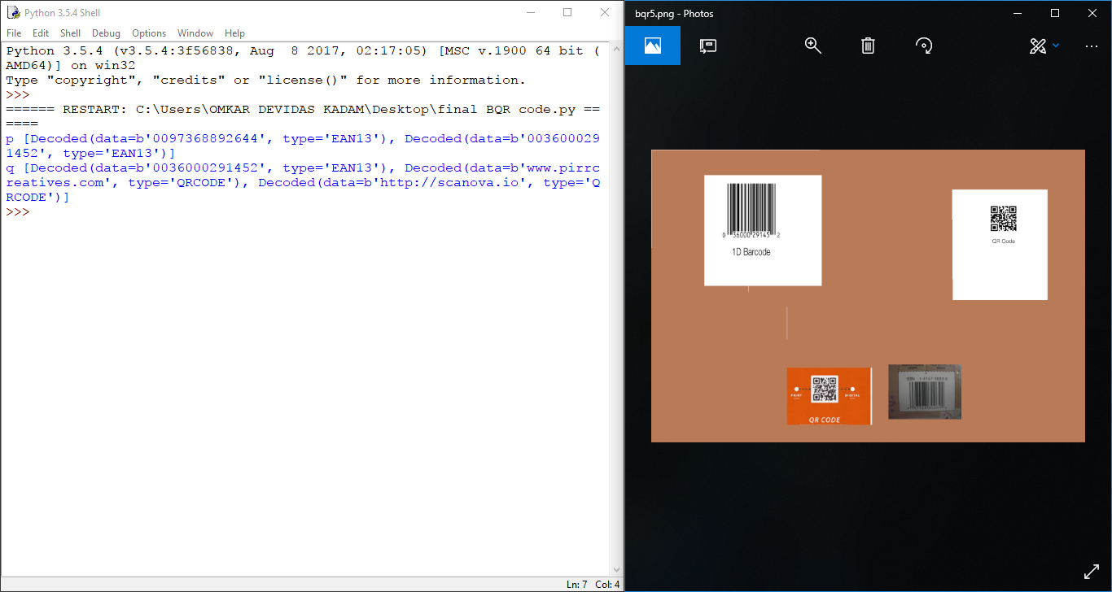

Slide 11
Budget and Resource Consumption

Slide 12
References
opencv-python-tutroals.readthedocs.io
pyimagesearch.com
stackoverflow.com
www.github.io
www.raspberrypi.org
Software used:
Python
OpenCV
Haar Cascade
Raspberry Pi - Rasbian
Pyzbar

